Slide 1

ML@B Bootcamp
git clone https://github.com/jpark96/ml-b-bootcamp-public
cd docker-setup
Fall 2016 Recruitment

Slide 2









The Team
Jin Park - Bootcamp Coordinator
William Guss - Director of Research
Brenton Chu - Director of Admin
Raul Puric - Head of Developers
Philip Kuznetsov - Head of Education

Slide 3





How do machines learn?
Red
Red
Red
Blue
Blue
Blue
Blue
Classifier Baby
Notes:
Baby knows nothing
A bunch of shapes with labels

Slide 4
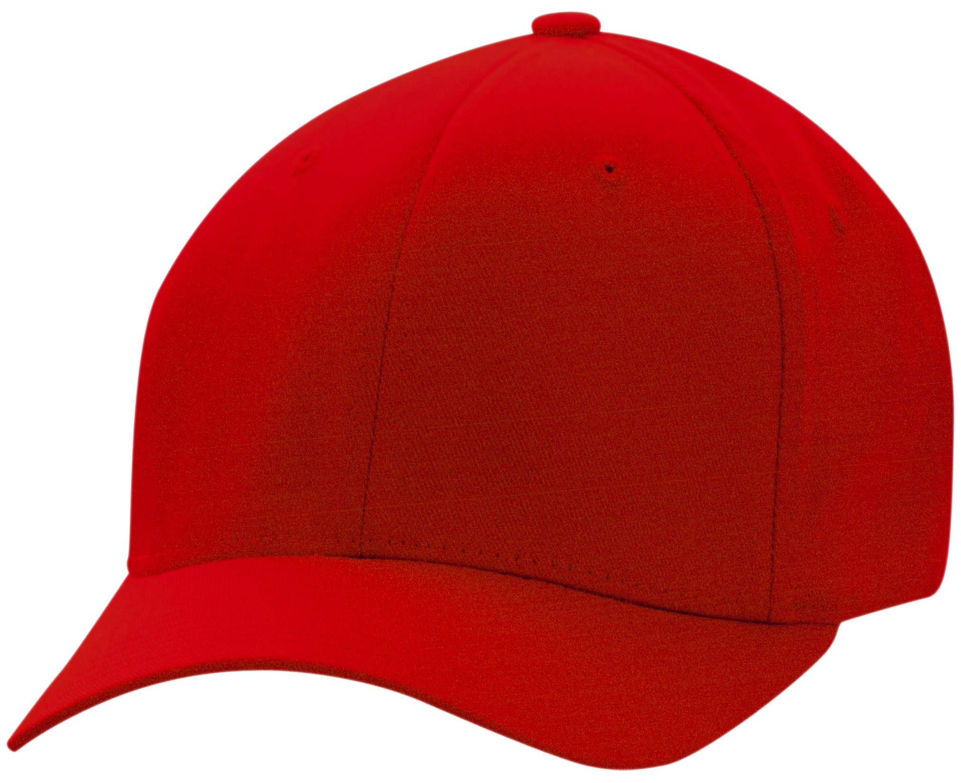
How do machines learn?
Red
Blue
Red!
Blue!
Red!
Classifier Baby
Notes:
Once the baby learns which data points are “red”
It can predict other data like it (interpolation)
It can predict

Slide 5
Learning Objectives
Learn key terms: class, classifier, decision boundary, risk/objective function, features
Implement gradient descent for perceptron algorithm
Understand the perceptron algorithm and nearest neighbors
Aware of underfitting/overfitting as well as ways to tackle it

Slide 6
The Basics

Slide 7
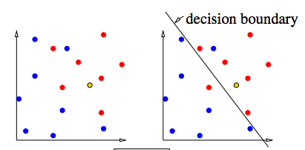
Perceptron: Problem
A linear classifier must find the decision boundary that separates sample points into two different classes.
Class: category or label
Decision Boundary: the boundary chosen by the classifier to separate items in the class from those not
Linear Classifier: the decision boundary is a line/hyperplane
Features: dimensions of a sample point

Slide 8
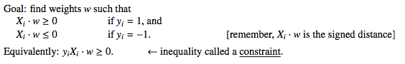
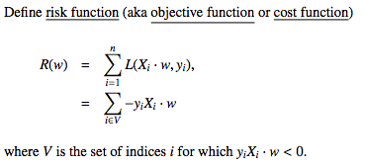
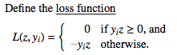
Perceptron: Risk Function

Slide 9
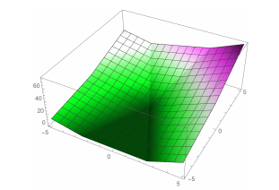
Perceptron: Risk Function

Slide 10
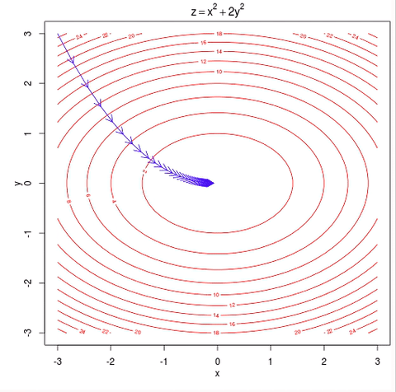
Perceptron: Gradient Descent

Slide 11
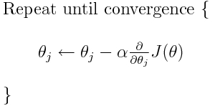
Perceptron: Gradient Descent

Slide 12
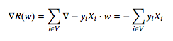
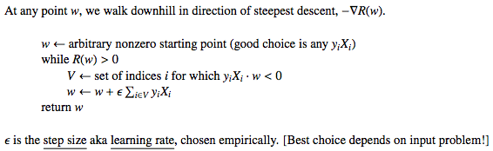
Perceptron: Algorithm

Slide 13
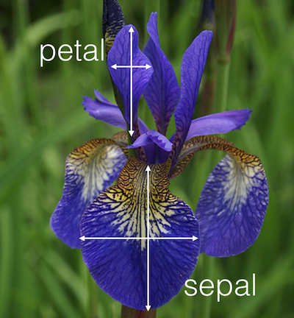
Implement Perceptron Algorithm with Iris Dataset

Slide 14
Dealing with Bias

Slide 15
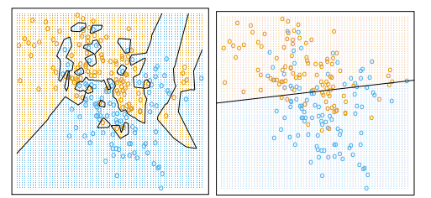
K-Nearest Neighbor Visualization
Notes:
Sometimes we want a nonlinear boundary
Nearest neighbors allows you to capture nonlinear/polynomial boundaries

Slide 16
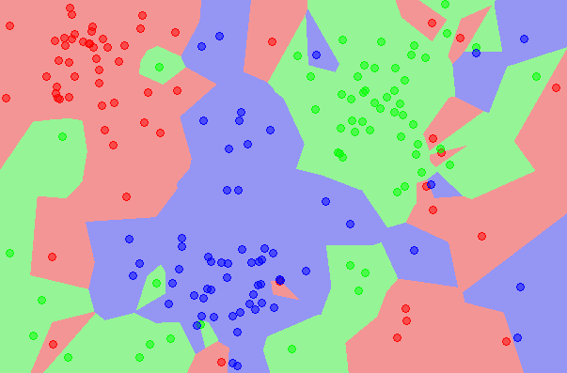
K-Nearest Neighbor Algorithm
Notes:
Basically, group of datapoints create a region, or “cells”
If a test data point is in a cell, that data point is predicted as that color

Slide 17
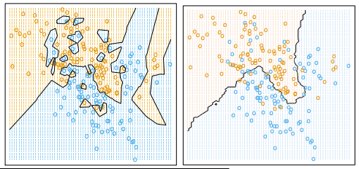
How do you choose the right “k”?
K = 5
K = 10

Slide 18
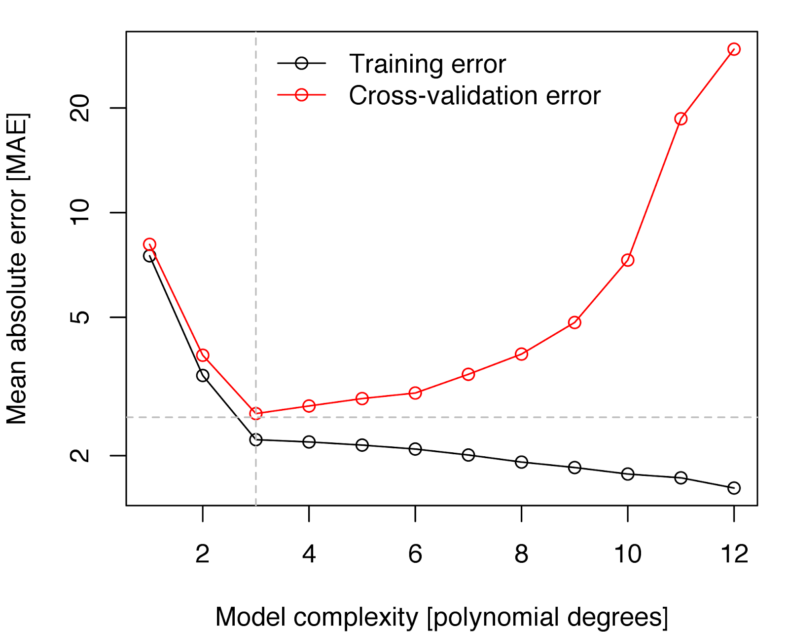
Different Types of Errors
Test
Notes:
Training Error: Error on all training points
Test Error: Error on all test points
Cross-Validation Error: special way to split training and test/erro

Slide 19
Overfitting/Underfitting
Notes:
Overfitting: model is too complex -> doesn’t generalize well -> low training error, high test error
Underfitting: model is not complex enough -> high training error, high test error

Slide 20
Overfitting/Underfitting
K = 5
K = 10

Slide 21
Cross-Validation And Regularization

Slide 22
Data Extraction

Slide 23

How do we deal with real data?
Binning!
Notes:
Real -> Discrete
Categorizing credit scores: low risk, medium risk, high risk
Categories -> Discrete
Labels are red, blue, green
Enhancing Accuracy

Slide 24
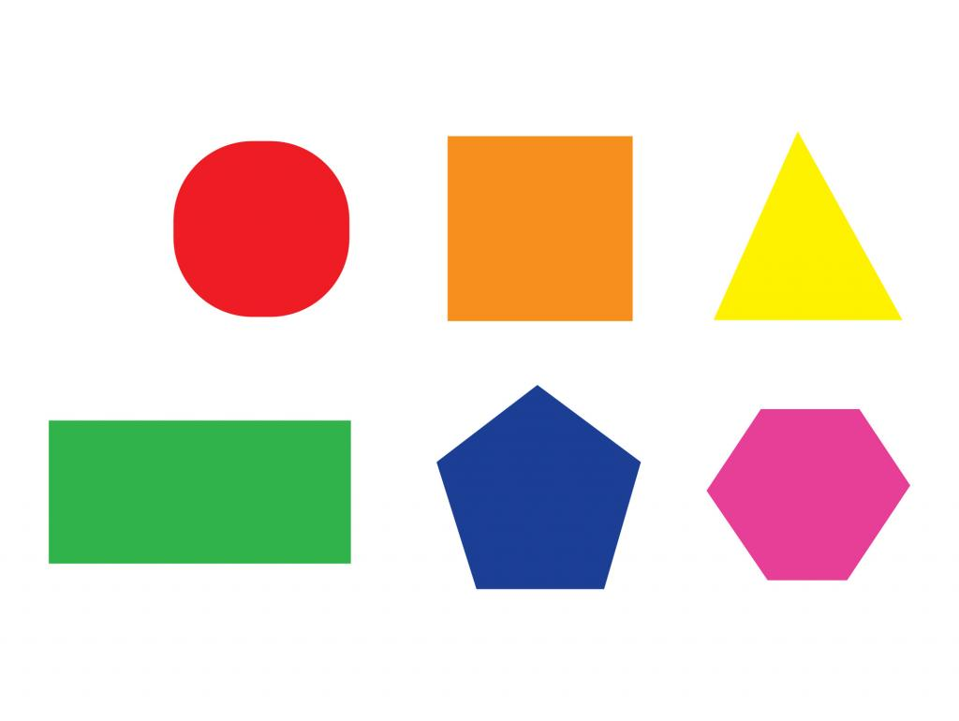
How do we deal with categorical data?
One hot encoding
Notes:
Real -> Discrete
Categorizing credit scores: low risk, medium risk, high risk
Categories -> Discrete
Labels are red, blue, green
Enhancing Accuracy

Slide 25
Techniques
Bucketing / Binning
Credit Scores
One Hot Encoding
Doc2vec, digits
Mathematical transformations
Notes:
Credit Scores can be split into low, medium, and high scores. Everything from 400-500 is low, 5-600 is medium, and 6-700 is high.
Binning can have better performance in practice!
One Hot Encoding is used for categorical -> discrete values

Slide 26
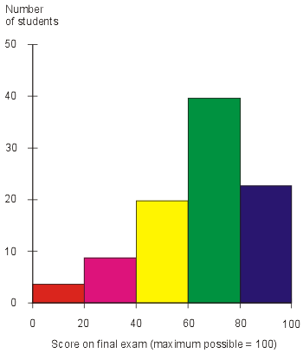
Bucketing
Convert values from continuous ranges into fixed ranges
IE Ages of students in the class -
Instead of splitting by year, we can group by those students age <18, 18-22, and 22+
Best visualized by histograms.
Notes:
There are situations when representing people from 18-24 yr olds together (college) is better.

Slide 27
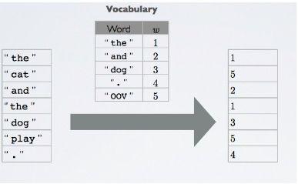
One Hot Encoding
Changes categorical variables into discrete values
[11cm, Red, 0]
Red, Green, Blue
[11cm, RED, NOT GREEN, NOT BLUE, 0]
[11cm, 1, 0, 0, 0]
Notes:
Once you bin into categorical variables, these categories need to be represented as categories, not numbers.
How do you represent categories with numbers?
Example: if you represent 0 - red, 1 - blue, 2 - green. Blue isn’t the mean of red and green
Make every category a boolean value in different dimensions

Slide 28
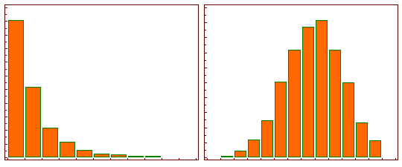
Mathematical transformations
Apply mathematical transformation that deterministically maps each datapoint to a new value.
Most useful is log transformation
Notes:
Perception is based on a logarthmic scale.
Train sensory signals in logarthmic scale

Slide 29
Summary

Slide 30
Learning Objectives
Learn key terms: decision boundary, risk/objective function
Implement gradient descent for perceptron algorithm
Understand the perceptron algorithm and nearest neighbors
Aware of underfitting/overfitting as well as ways to tackle it

Slide 31
Next Time
Neural Networks, Decision Trees/Random Forests
Unsupervised Learning
LEARN WITHOUT LABELS!

Slide 32
DAY 2

Slide 33
Learning Objectives
Decision Trees/Random Forest
Information Gain/Entropy
O(nd) runtime
Neural Networks
Sigmoid activation
Feedforward/Backpropogation
Unsupervised Learning
Clustering
PCA

Slide 34
Decision Trees

Slide 35
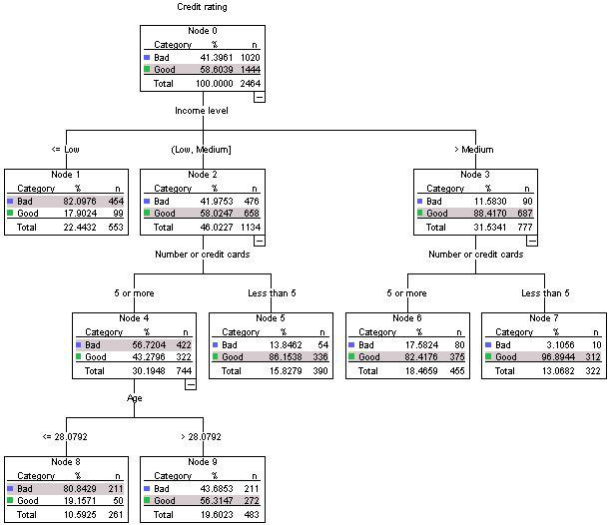
For any level, which feature should I split on?
Notes:
Decision Tree is a classifier
How does it classify? Walks down the tree until label

Slide 36
Information Gain
Problem: Did Brenton go outside or nah?
Features: DofW, Weather
Day of Week?
Weekday
Weekend
Which feature has more information gain: weather or day of the weak?
4 Outside
6 Inside
6 Outside
4 Inside
Weather?
Sunny
Rainy
8 Outside
2 Inside
2 Outside
8 Inside
Notes:
Example: predict whether a particular person is going to be outside in the park or indoors on a given day
20 data samples, 10 outside, 10 inside; knowing weather gives you more information than knowing day of the week

Slide 37
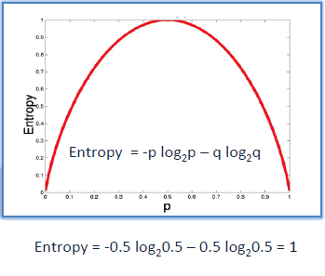
Entropy
Way to quantify information gain
Lower entropy = higher info gain!
Notes:
P = probability of event, q = probability of not event
Low entropy -> less “spread out” -> labels cluster together -> more confidence in decision
High entropy -> high “spread out” -> labels spread out -> less confidence in decision

Slide 38
Decision Tree Pseudocode
function split(node, features):
if all_same_class(node):
return Leaf(class(node))
for each feature in features:
branches = separate(node, features)
for each branch in branches:
entropy(branch)
weight entropy on branch size
retain branches with most entropy loss
features.remove(split_feature)
for each branch in retained_branches:
split(branch, features)
Splits until there are no more features/samples
Total runtime = O(ndlog(n))
Can optimize (e.g. pruning) for better performance
Notes:
Go through algorithm

Slide 39
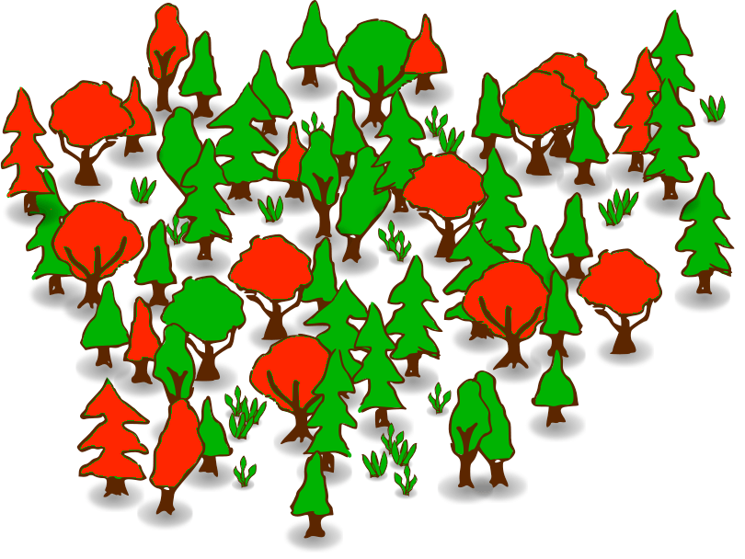
Random Forests
Ensemble learning using many decision trees
“Randomizes” decision trees using data and feature bagging
Plurality vote becomes prediction

Slide 40
Neural Networks

Slide 41
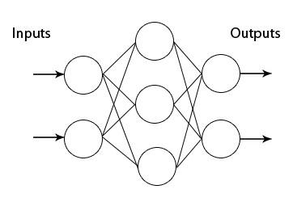
Multilayer Perceptrons
Notes:
Neural networks are pretty much multilayer perceptrons
Say I link the inputs of a perceptron to the output of another perceptron… what’s the issue?
How do I perform minimize the cost function? Gradient descent?
Doesn’t this just decompose to a perceptron?

Slide 42
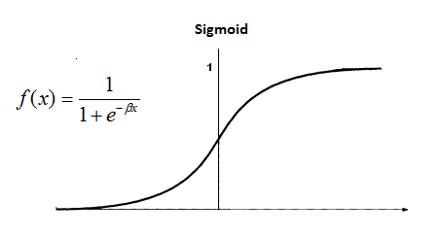
Activation Functions
Makes NN’s a nonlinear classifier!!
Sigmoid/softmax often used at end for classification
ReLU is common between neural network layers to resolve vanishing gradient
Tanh to give smooth output from -1 to 1

Slide 43

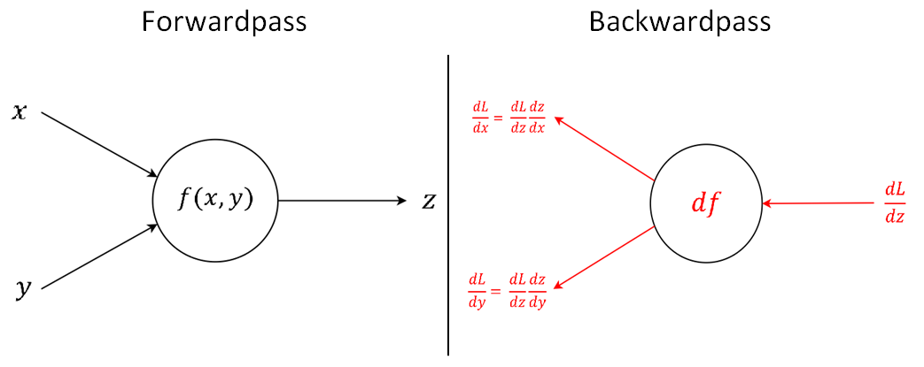
Feedforward/Backpropogation
Feedforward until predicted output
Backpropogate the gradients to adjust weights of each perceptron
VERY SIMILAR TO GRADIENT DESCENT
Notes:
Terms: Input Layer, Hidden Layer, Output Layer
How do we perform gradient descent?
Training
Feedforward and PREDICT point
If incorrect, backpropogate gradient descent for every single perceptron. Each perceptron has its own model, so you’d be adjusting the weights of each perceptron
Repeat until convergence

Slide 44
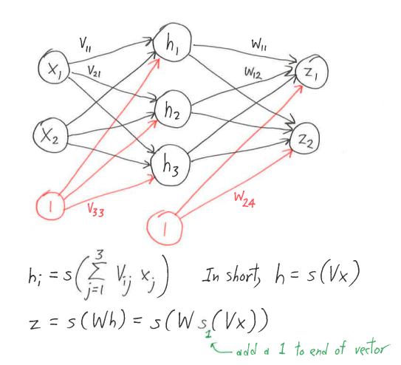
Feedforward Math
Each layer is a weight matrix dotting inputs followed by an activation
In other words: h=s(Vx)
Note: V, W represent the “weights of the perceptron at each layer”. Think about it!

Slide 45
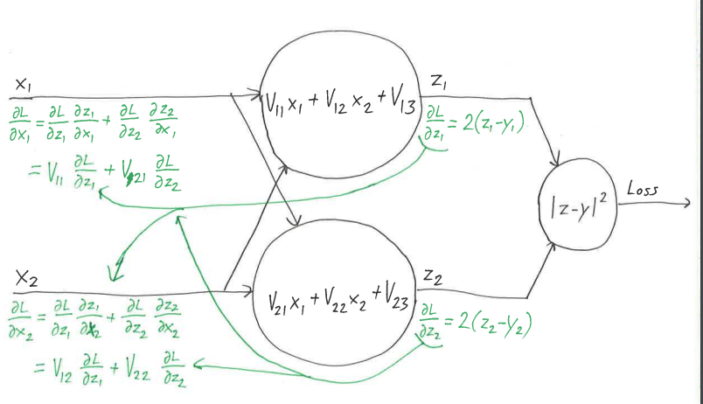
Backpropogation Math
Gradient update propagates backward using chain rule
Notes:
How do we adjust weights of V and W?
Note: THIS IS NOT THE NEURAL NETWORK! THIS IS A “FUNCTIONAL” NETWORK, for finding the gradient of each layer

Slide 46
Neural Network Algorithm
Repeat until convergence: For sample in samples: 1. Feedforward(sample) 2. Backpropogation(sample)
Repeat until convergence: For sample in samples: W = W - step_size * delta_J(sample)

Slide 47
Potpourri for Neural Networks
Append 1 for input layer + hidden layer to reduce bias
Dropout to avoid overfitting and “stuck neurons”
Adjust activation functions
Convolutions Neural Network (CNN)
Hidden layers of “convolutions and pooling”
Convolutions = submatrix transformation
Pooling = reduction of a submatrix
Recurring Neural Network (RNN)
Outputs of Neural Network are put as inputs
SIMULATES TEMPORAL MEMORY
Notes:
How do we adjust weights of V and W?
Note: THIS IS NOT THE NEURAL NETWORK! THIS IS A “FUNCTIONAL” NETWORK, for finding the gradient of each layer

Slide 48
Unsupervised Learning

Slide 49
Overview
Clustering: partition data into groups of similar/nearby points
Dimensionality reduction/embedding: identify unnecessary features and remove, or use existing features to add another feature’s worth of information

Slide 50
Clustering

Slide 51
Clustering
K-means/mediods
Hierarchical
Spectral graph partitioning and clustering

Slide 52
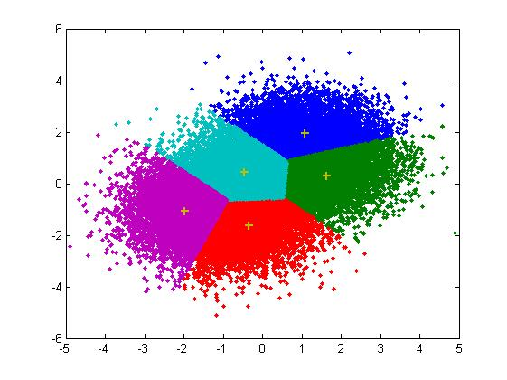
K-Means/Medoids
Goal: Partition n points into k disjoint clusters centered around a mean.
Randomly initialized (ie. nondeterministic results)
Doesn’t know what the clusters mean and has no labels

Slide 53
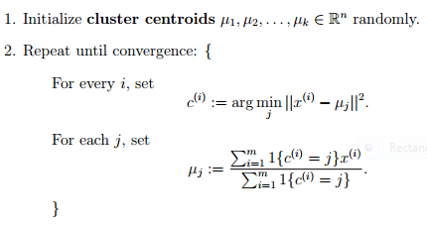
K-Means/Medoids
PseudoCode:

Slide 54
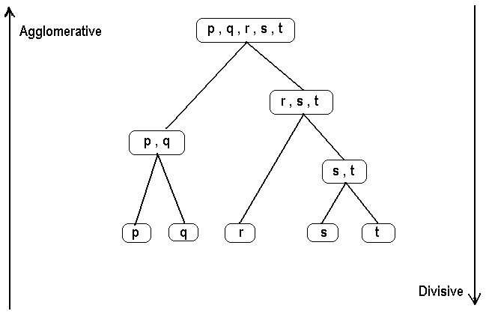
Hierarchical Clustering
Goal: Creates a tree where every subtree is a cluster.
Bottom-up (agglomerative)
pair clusters together until all point are in one top-level cluster
Top-down (divisive)
Start with all points in one cluster and repeatedly split

Slide 55
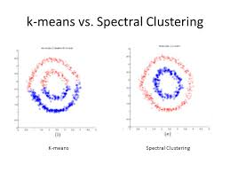
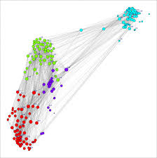
Spectral Clustering
Goal: Given a weighted, undirected graph G = (V, E), cut G into 2 (or more) pieces G_i of similar sizes.
e.g. Minimize the cut ratio
Cut(G_1, G_2)/(Mass(G_1) Mass(G_2))
Cut(G_1, G_2) = total weight of cut edges
Mass(G_1) = # of vertices in G_1 OR assign masses to vertice
Can be generalized to allow for more cuts/clusters

Slide 56
Dimensionality Reduction

Slide 57
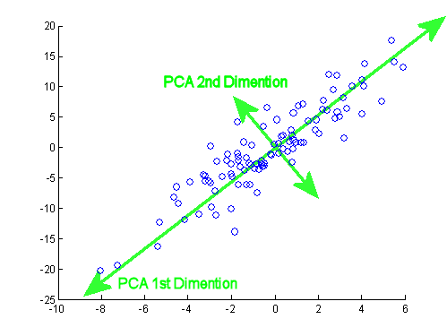
Dimensionality Reduction: PCA
Given sample points in R^d, find n out of d features that capture most of the variation.
Reducing size of data points makes computation cheaper.
Remove irrelevant dimensions, reducing overfitting

Slide 58
Dimensionality Reduction: PCA
PseudoCode: None. We will not ask you to implement this. We only want you to know how to use it
Basic example:
http://scikit-learn.org/stable/auto_examples/decomposition/plot_pca_iris.html
Has limitations and can only be used in scenarios where X^T X is a square, symmetric, positive semidefinite, d-by-d matrix
X is the zero centered (maybe normalized) data matrix
Eigenvectors of X^T X corresponding to first n largest eigenvalues are the first n principal components

Slide 59
Dimensionality Reduction: SVD
Almost identical to PCA in use case
More robust since X^T X can be anything
doesn’t have to be Positive semidefinite

